Slide 1
Aircraft Jet Engines and Propulsion
Systems
(Jet Propulsion and Control Quiz- Feb 14, 2012)
Dr. John Polley
Dr. K. Bofah

Slide 2
QUIZ – Feb. 14, 2012
Propulsion System Requirements
Control System Design
Modeling and Simulation
Hardware in the Loop
Engine Test
Aircraft/Control Tests
Aircraft Certification

Slide 3
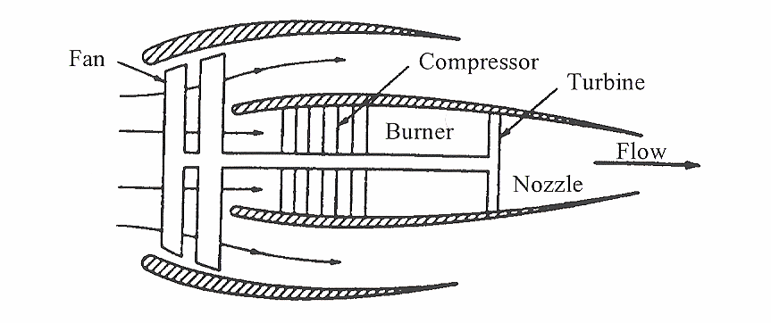
Engine Control System Design
What is the main purpose of an aircraft engine control system?
The plant is an Aerothermo device

Slide 4
Engine Control System Design
What is the main purpose of an aircraft engine control system?
The plant is an Aerothermo device
Purpose : inject fuel – get thrust as commanded by the Pilot

Slide 5
Engine Control System Design
2. What are the 4 key engine parameters protected by the control system?
The plant is an Aerothermo device

Slide 6
Engine Control System Design
2. What are the 4 key engine parameters protected by the control system?
The plant is an Aerothermo device
stall margin (fan , compressor)
overtemperature of (turbine hardware)
blowout of combustor
overspeed (fan, compressor)

Slide 7
Engine Control System Design
3. What is the required Accel time of an aircraft engine ? Who sets this requirement ?

Slide 8
Engine Control System Design
3. What is the required Accel time of an aircraft engine ? Who sets this requirement ?
The time it takes for an engine to go from throttle command to X percent of maximum (dry) thrust.
X may be 85%, 90%, or 95% depending on the Airframer (Boeing or Airbus)
Using FAA guidelines. It is about 5 seconds.

Slide 9
4
Describe Three Types of Engine Models Used in
Decreasing Level of Detail/Complexity

Slide 10
4
Describe Three Types of Engine Models Used in
Decreasing Level of Detail/Complexity
Detailed Nonlinear Aerothermo Model. Used for detailed performance calculations. Used for partial derivative linear models.
2. Real-Time, Component-Level Model (CLM)
A Simplified Transient Engine Model
Works as a Stand-Alone Model in test rigs
Coded to Run Within the Control Sample Time so it can represent an engine
Piecewise Linear Model (PLM)
A Number of Small Signal Models Derived from
1, and Stacked together
Form Partial derivative models
Used Commonly in Rig Tests (GE, Airframers)

Slide 11
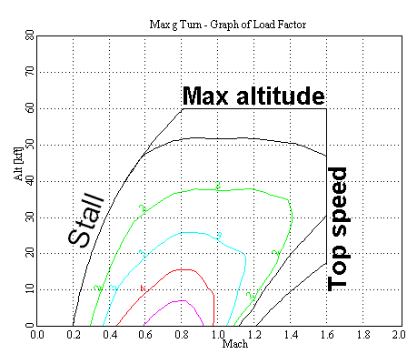
FLIGHT ENVELOPE
5
You are a newly appointed Aerospace Engineer in Company X. You have been
given a copy of the flight envelope for your project. What operational points do the black dots represent? What one other information will you need from the flight envelope .to continue your controller design?

Slide 12
FLIGHT ENVELOPE
5
Sea-Level Static
Sub sonic Cruise
Can be used to select Controller Operating Points

Slide 13
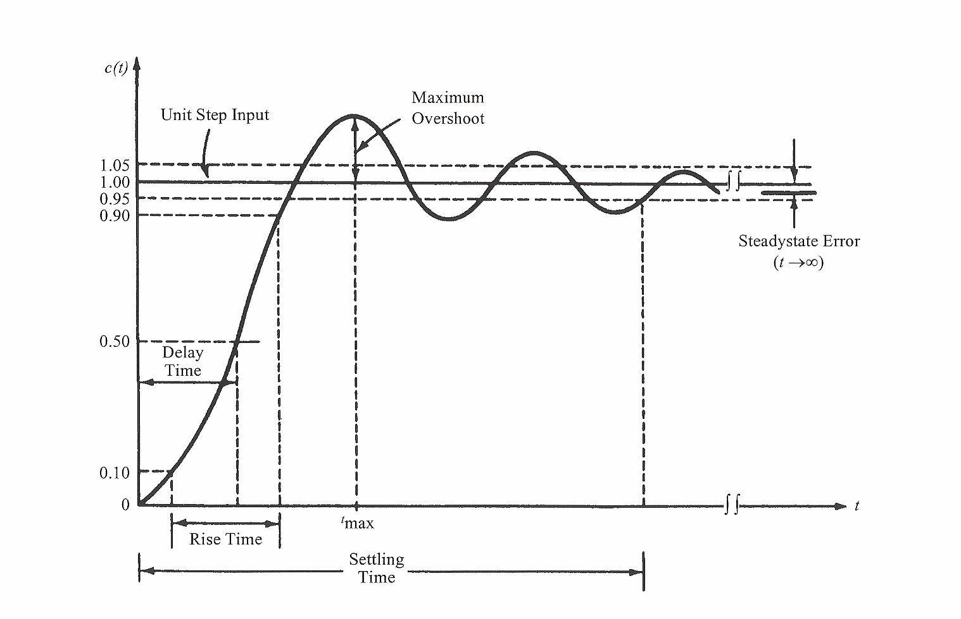
6. TYPICAL TIME RESPONSE TERMINOLOGY OF A CONTROL SYSTEM
Indicate the following time response specification of a dynamic system.
- Settling time, Rise time, Maximum Overshoot.

Slide 14
6. TYPICAL TIME RESPONSE TERMINOLOGY OF A CONTROL SYSTEM

Slide 15
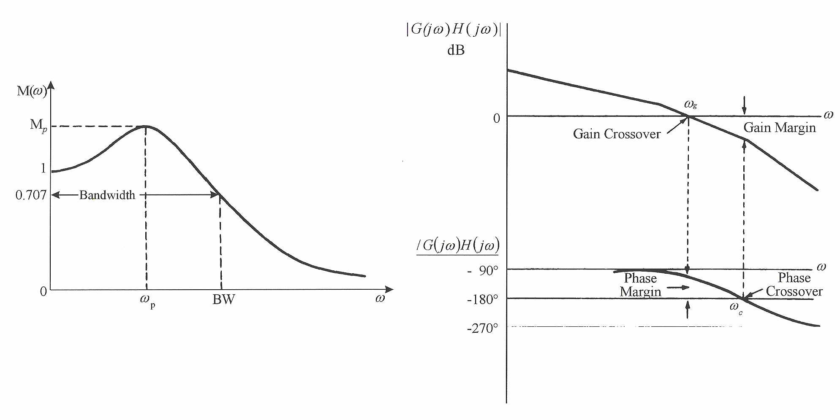
TYPICAL FREQUENCY RESPONSE TERMINOLOGY OF A CONTROL SYSTEM
7
Indicate the following frequency response specification of a dynamic system.
- Bandwidth, Gain Margin, Phase Margin.

Slide 16
TYPICAL FREQUENCY RESPONSE TERMINOLOGY OF A CONTROL SYSTEM
7
Indicate the following frequency response specification of a dynamic system.
- Bandwidth, Gain Margin, Phase Margin.

Slide 17
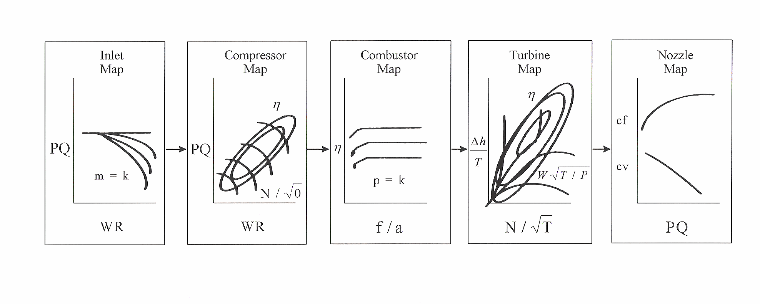
8. Component Map Role in the Engine Simulation
List 5 maps that are used to simulate an aircraft engine
physical behavior in steady-state models. Fill in the
question marks.
? ( )
?( )
? ( )
? ( )
? ( )

Slide 18
8. Component Map Role in the Engine Simulation
List 5 maps that are used to simulate an aircraft engine
physical behavior in steady-state models.
? (Inlet)
?(Compressor)
? (Combustor)
? (Turbine)
? (Exhaust Nozzle)

Slide 19
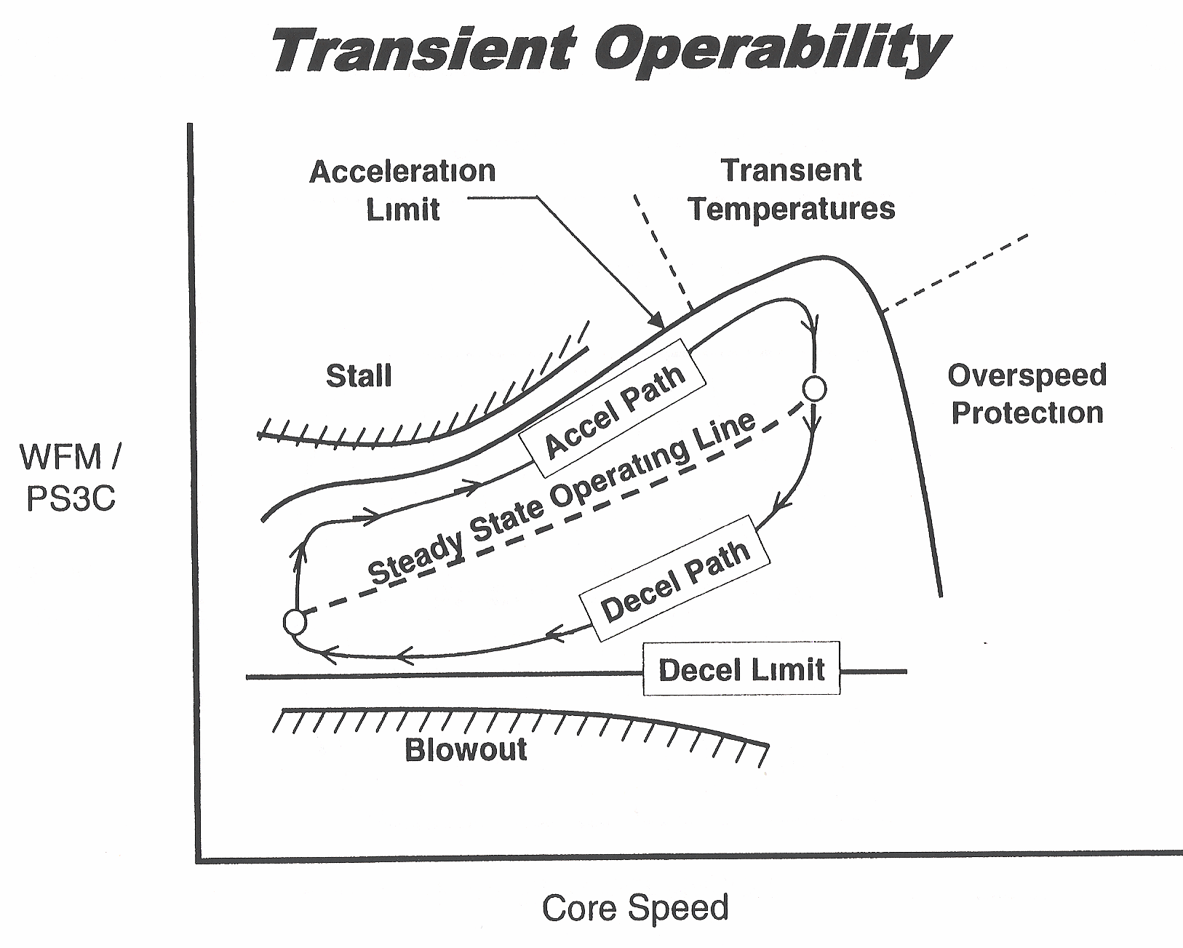
9. Describe the complex operation of aircraft engine control.
Include variables to be protected.

Slide 20
Follow steady-state operating line, accel path increasing power decel path decreasing power ,obeying Accel limit, Decel Limit , Protection required variables (stall, temperature ,overspeed,, blowout )
9

Slide 21
10. Engine Speed Control Loop
Identify the Engine Speed CLOSED Loop Control Loop. Name the modules
Identify the Inner Metering Closed loop modules. Which loop is faster.
FAN
SPEED
DEMAND
CLOSED-LOOP
FAN
SPEED
INNER
CLOSED-LOOP
TLA
FADEC
FMU
ENGINE
WFACCEL
FMV
ACTUATOR
POSITION
THRUST
Fan
Speed
Error
CURRENT
mA
FUEL
FLOW
+
FMV
Position
Control
METERING
VALVE
POSITION TO FUEL
FLOW
ENGINE
DYNAMICS
and
SENSOR
FAN
SPEED
FAN
SPEED
DEMAND
Fan
Speed
Regulator
FMV
DEMAND
FMV
SERVO-
ACTUATOR
-
WFDECEL
SENSOR
K_{LVDT}
MANIPULATED VARIABLES
(Commercial Engines)
Fuel Flow (WFM)
Variable Stator Vanes (VSVs)
Variable Bleed Valves (VBVs)
FAN SPEED
SENSOR

Slide 22
10. Engine Speed Control Loop
Outer Loop --- FADEC, FMU, FAN SPEED SENSOR
Inner Loop --- FMV Position Control,, FMV Servo ACTUATOR and Klvdt SENSOR
Inner Loop is FASTER
FAN
SPEED
DEMAND
CLOSED-LOOP
FAN
SPEED
INNER
CLOSED-LOOP
TLA
FADEC
FMU
ENGINE
WFACCEL
FMV
ACTUATOR
POSITION
THRUST
Fan
Speed
Error
CURRENT
mA
FUEL
FLOW
+
FMV
Position
Control
METERING
VALVE
POSITION TO FUEL
FLOW
ENGINE
DYNAMICS
and
SENSOR
FAN
SPEED
FAN
SPEED
DEMAND
Fan
Speed
Regulator
FMV
DEMAND
FMV
SERVO-
ACTUATOR
-
WFDECEL
SENSOR
K_{LVDT}
MANIPULATED VARIABLES
(Commercial Engines)
Fuel Flow (WFM)
Variable Stator Vanes (VSVs)
Variable Bleed Valves (VBVs)
FAN SPEED
SENSOR

Slide 23
11. What is the fundamental equation for describing
and adding the transient characteristics to the steady- state aircraft engine model? Fill in the question marks
Governing Equation of Engine Transient Model
T = IK d( ? )/dt
where: T - ( ? ) ---- ft lb
K - Conversion Factor ---- rad/sec/rpm
I - ( ? ) ---- slug ft²
Rotor Inertia,
Rotor Torque
Rotor Speed

Slide 24
11. What is the fundamental equation for describing
and adding the transient characteristics to the steady-state aircraft engine model? Fill in the question marks
Governing Equations in Transient Model
T = IK d(XN)/dt
where: T - Rotor Torque ---- ft lb
K - Conversion Factor ---- rad/sec/rpm
XN - Rotor Speed ---- rpm
I - Rotor Inertia ---- slug ft²

Slide 25
REFERENCES
“JET PROPULSION” A simple guide to the aerodynamic and thermodynamic design and performance of jet engines by Nicholas Cumpsty, University of Cambridge
“INTRODUCTION TO FLIGHT” by John D. Anderson, Curator of Aerodynamics, National Air and Space Museum, Smithsonian
Institution and Professor Emeritus, University of Maryland.
“GAS TURBINE PERFORMANCE” by Philip P. Walsh, Chief of Design Technology and Advanced Engineering Rolls-Royce Industrial and Marine Gas Turbines Ltd and Paul Fletcher, Principal Engineer, Advanced Projects, Rolls-Royce Industrial and Marine Gas Turbines Ltd

